Slide 1
Digital Bond
Website New Design

Slide 3
Home

Slide 4
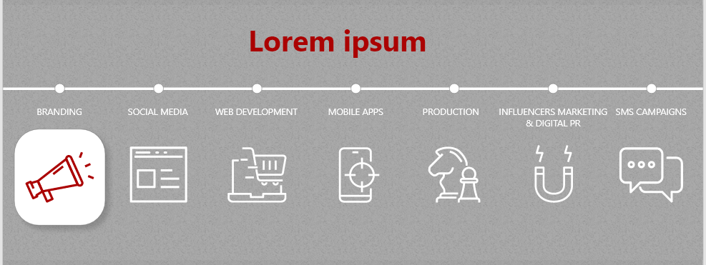

Services
Services

Slide 5
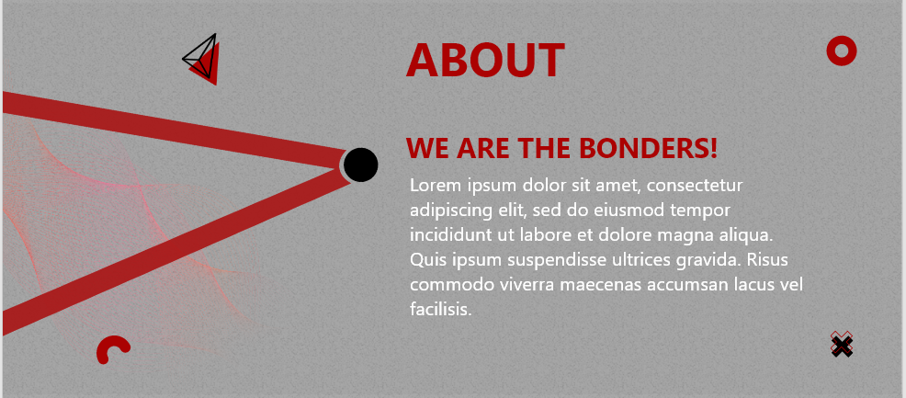
About
WE ARE THE BONDERS!
Bonders are a blend of cheerful, uprising and creative peeps working to deliver outstanding services. We are committed and loyalty runs in the veins; when we are put together our results blow minds.

Slide 6
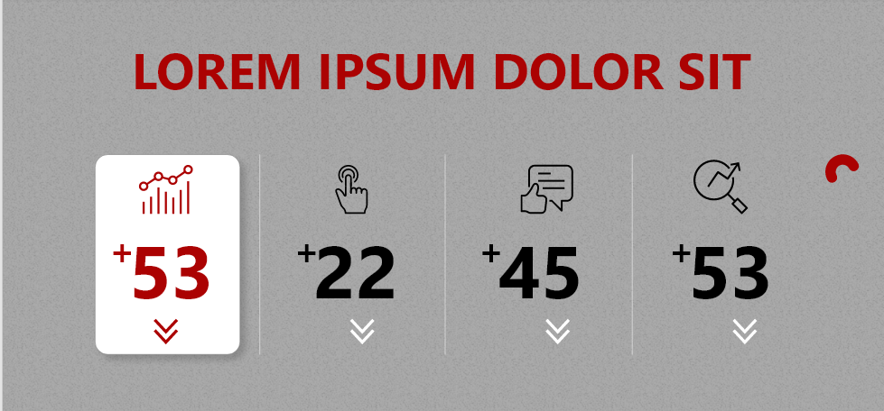
Counter
Digital Bond In Numbers!
Creative Ideas – Pending Projects – Satisfied Clients – Success Partners
+999 – +55 – +95 – +10

Slide 7

Happy Clients

Slide 8
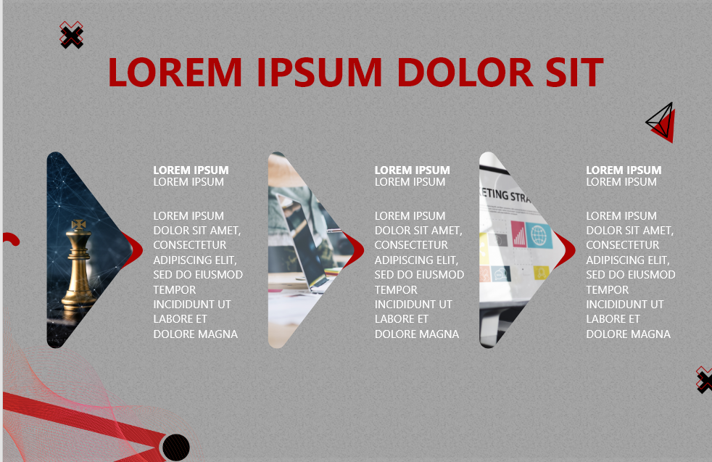
Read From Bonders
Inner
Pages
Is required
Why content is the king?
https://www.marketingdonut.co.uk/online-marketing/content-marketing/why-content-is-king-in-today-s-marketing
The Power of Branding
https://www.ronsela.com/power-of-branding/
Marketing Basics: The Essentials You Must Know
https://www.ronsela.com/marketing-basics/

Slide 9
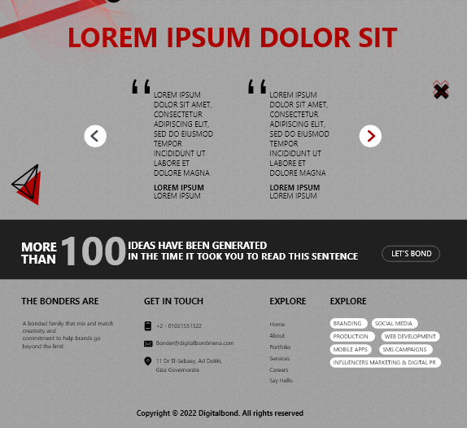
Clients Reviews
They believe in client success and have an array of tools and expertise to make that happen, from digital marketing to SEO, to website design.
Khaled Mostafa
Managing Director
Best of all, Digital Bond has a dedicated and responsive team that is open to ideas!
Mostafa Mourad
CEO
They are a very professional and dedicated team. Lifting lots of burden off our shoulders. Would strongly recommend them to other SMEs.
Marwa Mamdouh
Business Owner

Slide 10
Services

Slide 11
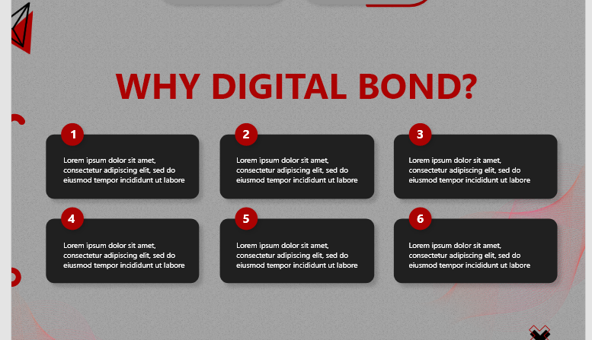
Services
Attention to Details
It’s our attention to the small stuff, scheduling of timelines and keen project management that makes us stand out from the rest.
Creativity
We bring our diverse background of advertising, design, branding, public relations, research and strategic planning to work for your company.
Pricing
Our prices are competitive and fair. There are no surprise bills. Any unexpected or additional expenses must be pre-approved by you.
Track Record of Success
We’ve worked with a range of top businesses in Egypt and abroad.
Long-term Partnerships
Your account manager will always be on hand to discuss your questions and concerns.
Our Clients Are Happy
Nothing gives us greater pride than seeing our clients delighted with the work we’ve done together.

Slide 12
Contact Us

Slide 13
Contact Us
Personal Information
How Can We Help
Thank You!
Thank you message will appear
Name
Title
Email
Phone Number
Write a message

Slide 14
Careers

Slide 15
Careers
Job Details
Job Description
Job Requirements
Similar Jobs
Explore More

Slide 16
THANK YOU
Let’s Bond Together!
002-01021551322
Bonder@digitalbondmena.com
https://digitalbondmena.com
11 Dr El-Sebaey , Ad Dokki , Giza Governorate

